Slide 1



Software Development II Module 8a Introduction to Web Servers & PHP
10/10/2020

Slide 2
SD2 Class will start shortly Make sure you’ve downloaded 08-ClassExercise.HTML from resources and have your web server running

Slide 3
Learning objectives this week
Web Servers
HTTP, Ports
Introduction to PHP
Filetypes: HTML vs PGP
The INCLUDE and REQUIRE Statements
Ensure you’ve downloaded the file 08-ClassExercise.html from Ilearn!

Slide 4
Functional Diagram ➔ Implementation
Log User IN
Login Functions
Log User OUT
Web Page to Login
Web Page to Select Login Option
Web Page:
to Login if not logged in ;
To log out if already logged in
Web Page to Select Log Out
Functions can be different code implementations

Slide 5
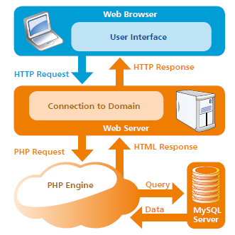
Our Software
HTML & CSS Web Pages
Abyss Web Server – handles HTTP requests from a Web Browser PHP – allows web pages to run “executable code”
MySQL – Database

Slide 6
Web Servers, HTTP, Ports

Slide 7
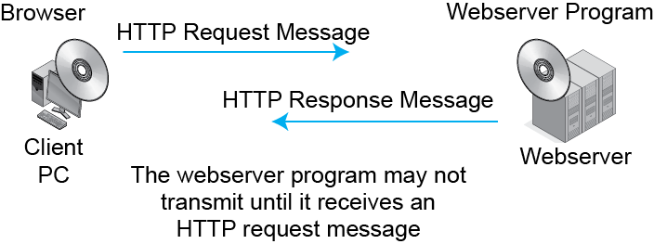
Refresher: HTTP Request/Response Cycle
The Client & Server make connections via PORTS!

Slide 8
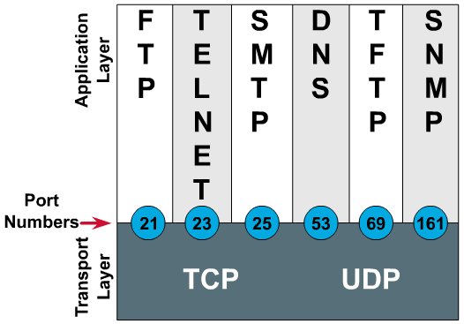
TCP/IP Port’s
A port is a communication end point. Ports are identified for each protocol.
Port numbers
indicate the
upper-layer
protocol that is
using the transport.
80 is the standard HTTP port for web SERVERS! CLIENTS use ephemeral ports!

Slide 9
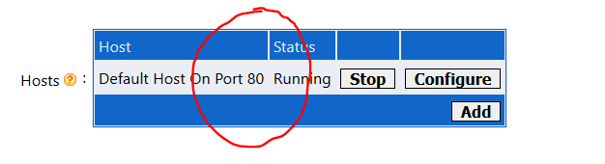
Port Types
Port numbers are assigned in various ways, based on three ranges:
System Ports (0-1023), System Ports are assigned by IETF process for standards-track protocols, as per RFC6335. Also known as well-known-ports
User Ports (1024-49151) ,User Ports are assigned by IANA using the "Expert Review" process, as per RFC6335
Dynamic and/or Private Ports (49152-65535), Dynamic Ports are not assigned, they are dynamically created as your computer need them. Also known as ephemeral ports.
NETSTAT command!
We’ll be using a port to run our Abyss Web Server Software

Slide 10
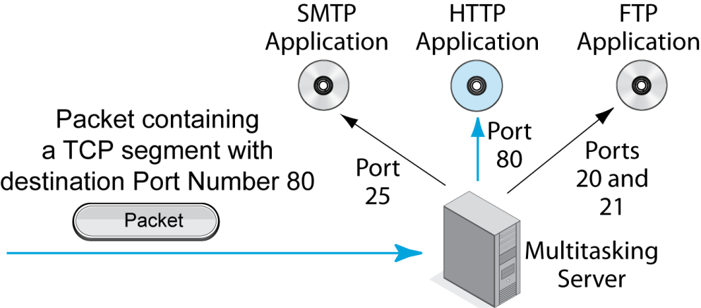
Refresher Server Port Numbers
An Analogy:
An airport <-> ip address Gate <-> port
Multitasking servers run multiple applications. Each is associated with a port number.
“Business Data Networks & Security"

Slide 11

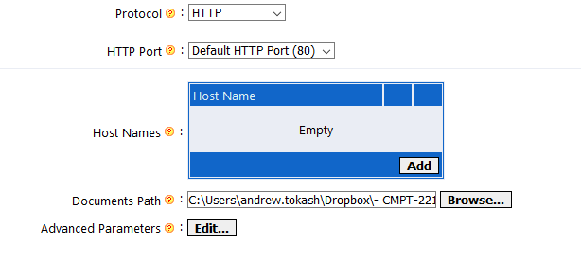
Localhost
The IP address 127.0.0.1 is reserved and usually means 'current computer'
We can also type "localhost" into our browser and it will be converted to 127.0.0.1
When we loaded Abyss we identified the "localhost" folder for PHP files

Slide 12
Sockets
Address + port
If we use host w/o port => default port
If we use host : port => overrides default port
Whenever we put a URL into our browser it opens a CONNECTION! ==> localhost : 127.0.0.1:80 (80 is default HTTP port) If we configured a DIFFERENT port (ex: 8888) then: ➔ localhost:8888

Slide 13
Web server operation
Tasks:
Accept connection on socket
Start HTTP session, if possible
Retrieve resource, if possible
Send resource via socket
End HTTP session
Close socket

Slide 14
PHP

Slide 15


Created by Rasmus Lerdorf (1995)
“Personal Home Page” tools
PHP: Hypertext Preprocessor (1998)
Recursive Initialism
Perl- and Java-like scripting language
Available today as free software
Abyss, Apache, EASYPHP, XAMPP, etc
Installed on over 30 million web pages, millions of web servers
Runs on the server
Output merged with HTML server sends to browser.

Slide 16
PHP
PHP: Hypertext Preprocessor (or simply PHP) is a general-purpose programming language originally designed for web development.
PHP code may be executed with a command line interface (CLI), embedded into HTML code, or used in combination with various web template systems, web content management systems, and web frameworks.
The standard PHP interpreter, powered by the Zend Engine, is free software released under the PHP License. PHP has been widely ported and can be deployed on most web servers on almost every operating system and platform, free of charge.
The PHP language evolved without a written formal specification or standard until 2014, with the original implementation acting as the de facto standard which other implementations aimed to follow. Since 2014, work has gone on to create a formal PHP specification.
PHP code is usually processed by a PHP interpreter implemented as a module in a web server or as a Common Gateway Interface (CGI) executable. (Do you remember configuring this?)
From Wikipedia

Slide 17
Online PHP Execution Apps
https://www.tutorialspoint.com/execute_php_online.php
http://www.writephponline.com/

Slide 18
PHP Basics
PHP files can contain text, HTML, CSS, JavaScript, and PHP code
PHP files have extension “.php”
PHP can generate dynamic page content
PHP can create, open, read, write, delete, and close files on the server
PHP can collect form data
PHP can send and receive cookies
PHP can add, delete, modify data in your database
PHP can be used to control user-access
PHP can encrypt data
A PHP script can be placed anywhere in the document
A PHP script starts with <?php and ends with ?>:
https://www.w3schools.com/php/php_intro.asp

Slide 19
Do you see any difference between these two lines of code? mysqli_connect ( ‘localhost’ , ‘mike’ , ‘easysteps’ , ‘site_db’ ) mysqli_connect ( 'localhost' , 'mike' , 'easysteps' , 'site_db' )
VERY Important Warning If you cut & paste instructions from the ebook version into your PHP or SQL code, make sure you change any “curly” quotes to “normal” quotes. If you don’t some code may and not explain WHY it is failing!

Slide 20
PHP Code Is Embedded In HTML
</tr>
<tr>
<td> headers </td>
<td> &lth1> - &lth5> </td>
</tr>
</table>
<?Php
echo "This text was created by PHP";
?>
<h2 style="text-align:center;"> CSS STYLES <h2>
<table border=1>
<tr>
<th> Style </th>
<th> Description <th>
The filetype will be *.php (not *.html)

Slide 21
PHP Code Can Create HTML code
<table>
<tr>
<?Php
echo “<th> Product ID </th>”; echo “<th> Model Number </th>”;
?> </tr>
<h2 style="text-align:center;"> CSS STYLES <h2>
<table border=1>
<tr>
<th> Style </th>
<th> Description <th>
PHP files can contA PHP script starts with <?php and ends with ?>:
You could use PHP to create almost the entire HTML code of the web page!

Slide 22
Filetypes: HTML and PHP
While bowsers can always support HTML filetypes, once your web server is running, your browser can now support PHP files.
We can rename all our project HTML files to PHP – this will allow us to encode PHP in them!
But if they are filetype PHP we MUST have our PHP engine running!
NOTE: If you put a valid filename in the URL: localhost\lab7.php and the php engine is NOT running, the browser will try to download the file!

Slide 23
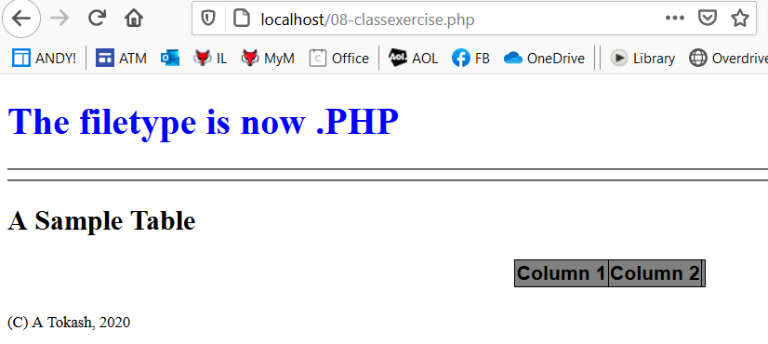
Filetypes – Exercise
Ensure ABYSS is configured so the default folder is C:\SD2 and that you’ve saved 08-ClassExercise.html in there
Point your browser to LOCALHOST\08-ClassExercise.HTML to verify
Now rename the file to 08-ClassExercise.php
Point your browser to LOCALHOST\08-ClassExercise.php to verify
Edit the file and change line 11 to: <header> <h1> The filetype is now .PHP </h1> </header>
Save and refresh the browser

Slide 24
The PHP INCLUDE & REQUIRE Commands
Rather than repeating common code in multiple PHP files, it can be placed in a separate “.php” file and called from other programs
Other programs can INCLUDE it or REQUIRE it
If the common code file is not found, INCLUDE displays a warning message, REQUIRE will create a critical error
Xxxxx
Xxxxx
Xxxxx
xxxxx
Aaaa
Aaaa
common code
Aaaaa
aaaaa
Aaaa
Aaaa
Require (common code);
Aaaaa
aaaaa
bbbb
common code
bbbb
bbbb
bbbb
Require (common code);
bbbb
bbbb
The common code

Slide 25
The PHP INCLUDE & REQUIRE Commands
The format of the commands if the common code file is in the same folder: REQUIRE (‘filename.filetype’); INCLUDE (‘filename.filetype’);
The format of the commands if the common code file is in the parent folder: REQUIRE (‘../filename.filetype’); INCLUDE (‘../filename.filetype’);
Think of where you can use this: Navigation. Headers. Footers.

Slide 26
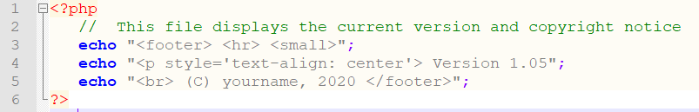
INCLUDE – Exercise
The bottom of our PHP file has this footer:
<footer> <small> (C) A Tokash, 2020 </footer>
Let’s create a separate file for our footer! This could then be used (included) by ALL our web pages. And let’s add our application version!
Step 1: Create new file: 08-footer.php Make sure you type this EXACTLY, especially with respect to the single and double quotes!

Slide 27
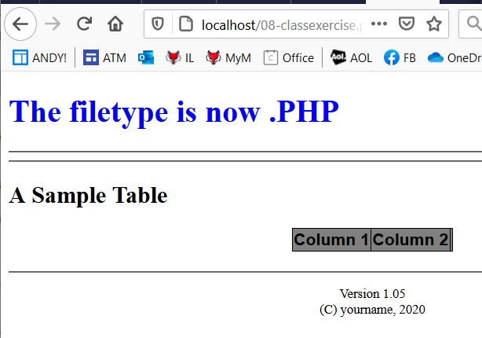
INCLUDE – Exercise
The bottom of our PHP file has this footer:
<footer> <small> (C) A Tokash, 2020 </footer>
Let’s create a separate file for our footer! This could then be used (included) by ALL our web pages. And let’s add our application version!
Step 2: Replace the footer line in the 08-ClassExercise.php with this: <?php include "08-footer.php"; ?>
Save and refresh your browser.

Slide 28
INCLUDE – Exercise
Step 3: change the include line statement to: <?php include "09-footer.php"; ?>
Save and refresh your browser.
Step 4: change the include line statement to: <?php require "09-footer.php"; ?>
Save and refresh your browser.
Step 5: change the include line statement to: <?php include "08-footer.php"; ?>
Save and refresh your browser.

Slide 29
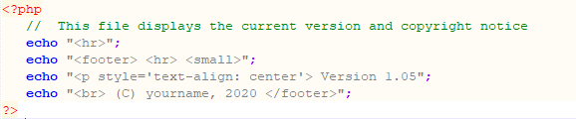
PHP Comments
// This is a single-line comment
/*This is a multiple-lines comment block that spans over multiple lines */
$x = 5 /* comments inside code */ + 5;
https://www.w3schools.com/php/php_intro.asp

Slide 30
Single Quotes & Double Quotes
Note that to display text we need to enclose it in quotes. We can enclose in either single OR double quotes, but we must be consistent – and we must end the quote. echo "This is a line of text"; echo 'This is a line of text';
Sometimes we need to include quotes inside the text – for example: to output html command with quotes. To do this we use one type of quotes for the 'outside' PHP command and the different type of quotes for the "inside" HTML command. Again, be consistent – and we must end the quotes.

Slide 31
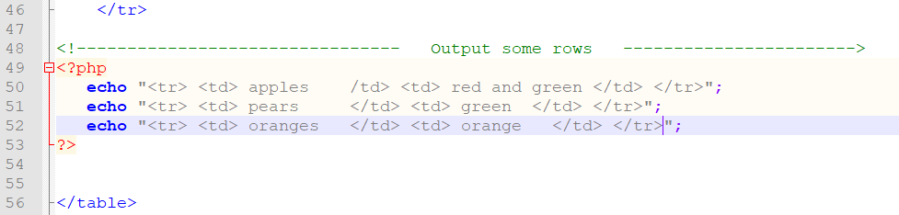
Creating HTML – Exercise
Using PHP we create extensive and DYNAMIC web pages
We’ll use PHP to retrieve data from our database and then use that to ‘write’ our HTML code
For example: For our product list, we’ll SELECT rows from the product table & ECHO commands (<tr>, <td>, etc.) and data.
Lets try to create some rows in our example file:
Save and refresh your browser.

